Slide 1
B (The language of B-Method )
Course: CAS760 Logic for Practical Use
Instructor: Dr. William M. Farmer
Ehsan Mohammad Kazemi
Department of Computing and Software
McMaster University
Winter 2010

Slide 2
OUTLINE
Introduction
History
Abstract Machine
Substitution Notation
Notation [S]P
Machine Consistency
Parameters, Sets and Constants

Slide 3
Introduction
B is a formal method for specifying, refining and implementing software.
Based around Abstract Machine Notation and used in the development of computer software.
It has robust, commercially available tool support for Specification, design, proof and Code generation.
The method of software development based on B is known as the B-Method.

Slide 4
The main idea and goal of B
The main idea:
To start with a very abstract model of the system under development and gradually add more details by building a sequence of more concrete model.
The main goal:
To obtain a proved model by creating a number of proof obligation which guarantee the correctness of the system.

Slide 5
History
B was originally developed by Jean-Raymond Abrial in France and the UK in the 1980s.
B is related to the Z notation ( also originated by Abrial and named after Zermelo–Fraenkel set theory) and supports development of programming language code from specifications.
B has been used in major safety-critical system applications in Europe, and is attracting increasing interest in industry

Slide 6
AMN(ABSTRACT MACHINE NOTATION)
A Specification Language and (abstract) Programming Language for specifying abstract machines in the B-Method
Based on the mathematical theory of Generalised Substitution

Slide 7
ABSTRACT MACHINE
An Abstract Machine is a specification of a system.
It contains pieces of Information that describe various aspects of the specification and list them under appropriate headings.
Any specification must describe what component can do

Slide 8
Body of Abstract Machine
MACHINE ...
VARIBALES ...
INVARIANT ...
INITIALISATION ...
OPERATIONS ...
END

Slide 9
A concrete example through the presentation
Example of ticket dispenser used in a shop to order a queue. Any new customer takes a new numbered ticket from the dispenser and when a sales assistant is ready to serve, a display indicates the number of the customer who is going to be served next, other customers wait until it is their turn to be served.

Slide 10
MACHINE
The MACHINE clause is used to provide the name of the machine
All machines in a development must have different names in order to allow other parts of a large specification to refer to them.
In case of the ticket dispenser example:
MACHINE Ticket

Slide 11
VARIABLES
All of the variables which are going to be used in the machine are simply listed in the VARIABLES clause.
In Ticket machine two pieces of information are important to maintain: the number of the next customer or ticket which will be given by the dispenser and the number of customer or ticket currently being served.
The VARIABLES clause in our case:
VARIABLES Serve, Next

Slide 12
INVARIANT
Provides all the information about the variables of the machine, such as their types and other constraints
Can also give some restriction on the variables possible values
The variables values change as the machine executes, but this clause describes the properties of variables which must be always True as the execution progresses.

Slide 13
INITIALISATION
The Initialisation clause is used to describe possible initial states of machine.
It consists of an AMN statement used to set the state in which the machine starts.
All variables listed in VARIABLES clause must be assigned some value.

Slide 14
OPERATIONS
Contains a list of operation definitions
Specification of operation generally provides:
The name of the operation
Input and Output parameters
What does the operation require, modify and do?

Slide 15

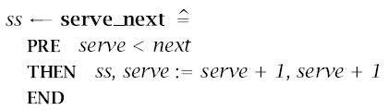
Operation Clause(Continue)
The Ticket machine offers two operations:
One to serve the next customer (serve-next)
One to provide a new customer with the next
Ticket (take ticket)

Slide 16
SUBSTITUTION
The notation of substitution is central to the use of the B-Method
An Expression E can be substituted for a free variable x (one not in the scope of a quantification) by replacing all free occurrences of x by the Expression E
Written as P[E/x] and read as P with E for x
For multi-Substitution P[E,....,F/x,....,y]

Slide 17

THE NOTATION [S]P
The notation [S]P denotes a predicate which is True of any initial state from which S is guaranteed to achieve p
Since [S]P is a condition on states before execution, it’s a precondition
Since it is true of all states which are guaranteed to achieve P, it is the weakest precondition.

Slide 18
ASSIGNMENT
SIMPLE ASSIGNMENT
MULTIPLE ASSIGNMENT
[serve, next := serve+1, next-1](serve<=next)

Slide 19
CONDITIONAL
Conditional statements allow branching depending on a particular value on the state
The most common form is If Then Else construction found in all imperative programming languages
The AMN form of this is:
IF E THEN S ELSE T END

Slide 20
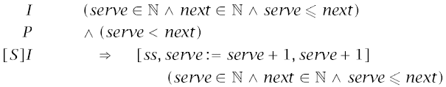
MACHINE CONSISTENCY
CONSISTENCY OF INVARIANT
PROOF OBLIGATION FOR INITIALIZATION [T] I
PROOF OBLIGATION FOR OPERATION

Slide 21
LOOPS
The complete template for a LOOP in AMN:
WHILE E
DO S
INVARIANT I
VARIANT v
END

Slide 22
PARAMETERS, SETS AND CONSTANTS
PARAMETERS :
Set-Valued MACHINE Name(SET-VALUED PARAMETER)
Scalar-Value MACHINE Name(Set-value parameter)
Scalar-valued parameters are given value in CONSTRAINTS clause
SETS: In addition to passing sets to a machine via parameters, it introduces some other types into the specification. Example:
SETS REPORTS={yes, no}, NAME
CONSTANTS: lists the name of the constants being used in the machine.
CONSTANTS total
Constant types are defined in PROPERTIES clause

Slide 23
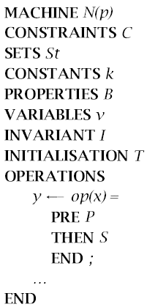
CONTINUED
PROPERTIES: This clause
describes the conditions that
must hold on the sets and
constants
It can also be related to the
parameters passed to the
machine.

Slide 24
References
[1] The B-Method: An Introduction, Steve Schneider, Palgrave, Cornerstones of Computing series, 2001
[2] http://en.wikipedia.org/wiki/B-Method

Slide 25
Thanks
Any Questions?

