Slide 1
Common Algebraic Specification Language(CASL)
Course: CAS760 Logic for Practical Use
Instructor: Dr. William M. Farmer
Ehsan Mohammad Kazemi
Department of Computing and Software
McMaster University
Winter 2010

Slide 2
Outline
History
Introduction
Underlying Concepts
Basic Specification
Structured Specification
Architectural Specification and Libraries
Examples
References

Slide 3
History
CASL, the Common Algebraic Specification Language, has been designed by CoFI, the Common Framework Initiative for algebraic specification and development.
The CoFI Language Design Group was formed at the founding meeting of the Common Framework Initiative in Oslo, Norway, September 1995.
There was an urgent need for a common framework because of abundance of specification languages.
The aim of CoFI was to propose a common framework which is able to replace many existing algebraic specification frameworks
An initial design of CASL was proposed in May 1997.
The design was finalized in April 1998, and CASL version 1.0 was released in October 1998.

Slide 4
Introduction
The Common Algebraic Specification Language (CASL)
Is a general-purpose Specification based on First Order Logic with Induction.
Partial Functions and Subsorting are also supported.
Has been designed by a large group of experts for practical use in software development .
Is an expressive language and is appropriate for specifying requirements and design for conventional software packages.
Is algebraic in the sense that models of CASL specifications are algebras.

Slide 5
Introduction(Continued)
CASL:
Includes selected features from many previous specification languages, as well as some novel features that allow algebraic specifications to be written much more concisely and perspicuously.
Has already attracted widespread interest within the algebraic specification community, and is generally regarded as a de facto standard, and is now accepted as an appropriate basis for research and development in algebraic specification
Represents a consolidation of past work on the design of algebraic
specification languages, and all its features are present in some form in other languages,

Slide 6
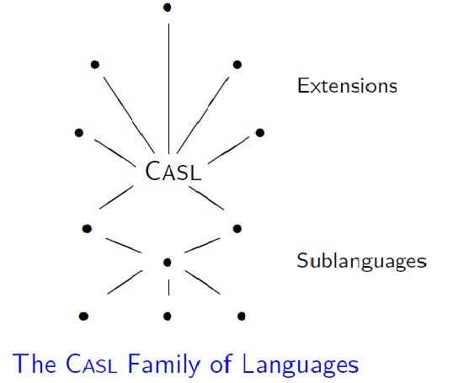
Introduction(Continued)
CASL is at the heart of a coherent family of languages that are obtained as sublanguages or extensions of CASL.

Slide 7
Underlying Concepts
CASL is based on standard concepts of algebraic specification, and has several major parts:
Basic specifications, for the specification of single software modules.
Structured specifications, for the modular specification of modules.
Architectural specifications, for the prescription of the structure of implementation.
Specification libraries, for storing specifications

Slide 8
Basic Concepts
A basic specification framework may be characterized by:
A class Sig of signatures Σ, each determining the set of symbols |Σ| whose intended interpretation is to be specified, with morphisms between Signatures.
A class Mod(Σ) of models, with homomorphisms between them, for each signature Σ.
A set Sen(Σ) of sentences (or axioms), for each signature Σ.
A relation |= of satisfaction, between models and sentences over the same signature.
A proof system, for inferring sentences from sets of sentences.

Slide 9
Basic Concepts (Continued)
A many-sorted signature Σ = (S,TF, PF, P) consists of:
A set S of sorts;
Sets TFw,s, PFw,s, of total function symbols, respectively partial function
Symbols, such that TFw,s ∩ PFw,s = ∅, for each function profile (w, s)
consisting of a sequence of argument sorts w ∈ S∗ and a result sort
s ∈ S (constants are treated as functions with no arguments);
Sets Pw of predicate symbols, for each predicate profile consisting of a
sequence of argument sorts w ∈ S∗.

Slide 10
Basic Specification
A basic specification generally consists of a set of declarations of symbols, and a set of axioms and constraints
The semantics of a basic specification is a signature and a class of models.
Basic specifications in CASL allows:
Declaration of sorts, subsorts, operations (both total and partial), and predicates.
The use of formulas of first-order logic for stating axioms.
Predicates are different from boolean-valued operations.
Operation symbols and predicate symbols may be overloaded.

Slide 11
Basic Specification(Continued)
Subsorts declarations are interpreted as embeddings.
Axioms are formulas of first-order logic.
Quantification
Logical Connectives
The atomic formulas in CASL axioms are equations (strong or existential), definedness assertions, and subsort membership assertions.
Sorts can be constrained to include only generated values.
Sort generation constraints eliminate ‘junk’ from specific carrier sets.

Slide 12
Structured Specification
Structured specifications are formed from basic specifications.
The semantics of a structured specification is simply a signature and a class of models.
A translation merely renames symbols.
Hiding symbols removes parts of models.
Union of specifications identifies common symbols.
Extension of specifications identifies common symbols too.
Generic specifications have parameters, and have to be instantiated when referenced.

Slide 13
Architectural Specification & Libraries
The semantics of an architectural specification reflects its modular structure.
The intention with architectural specifications is primarily to impose structure on implementations,
Architectural specifications involve the notions of persistent function and conservative extension.
A function F mapping Σ-models to Σ’-models, where the signature Σ’
extends Σ, is said to be persistent when for each Σ-model M, the reduct of F(M) to a Σ-model is exactly M.

Slide 14
Architectural Specification & Libraries
A specification extension SP’ of SP is said to be conservative when each model of SP can be expanded to a model of SP’.
A persistent function mapping models of SP to models of SP’ exists only if SP’ is a conservative extension of SP.
The semantics of a library of specifications is a mapping from the names of the specifications to their semantics.

Slide 15
Getting Started(Examples)
Simple specifications may be written in CASL essentially as in many other algebraic specification languages.
CASL provides also useful abbreviations.

Slide 16
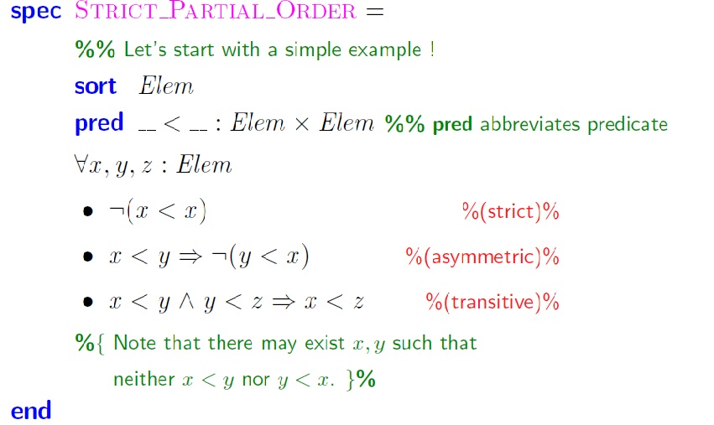
Example 1. CASL syntax for declarations and axioms involves familiar notation, and is mostly self-explanatory.

Slide 17
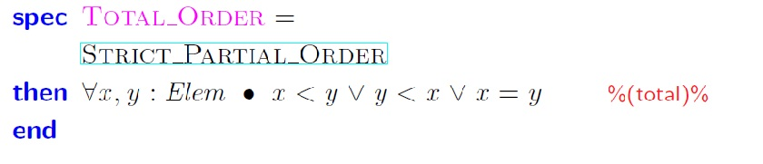
Example 2. Specifications can easily be extended by new declarations and axioms.

Slide 18
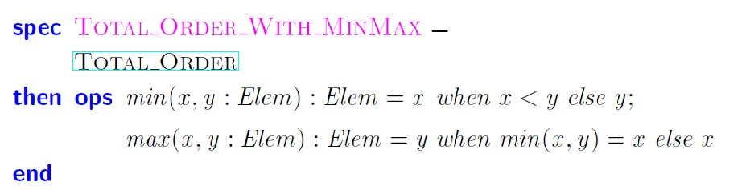
Example 3. In simple cases, an operation (or a predicate) symbol may be declared and its intended interpretation defined at the same time.

Slide 19
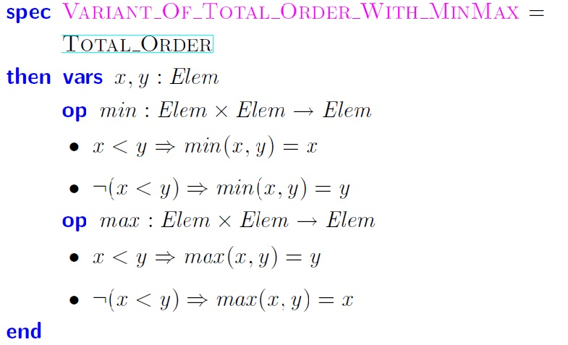
Flexibility of Example 3.

Slide 20
References
[1] CASL user Manual, Introduction to Using the Common Algebraic Specification Language, Michel Bidoit,
Peter D. Mosses, Springer, 2004
[2] CASL Reference Manual, Authors: The CoFI Language Design Group
[3] http://www.informatik.uni-bremen.de/cofi/wiki/index.php/CoFI
[4] http://en.wikipedia.org

Slide 21
Thank you
Questions?

